Slide 1
Diabetes Prediction Project
Augustine Ogbonnah

Slide 2

Problem Statement: Stark Health Clinic is facing a growing challenge in managing diabetes, a condition that poses severe health risks to patients and significant costs to the healthcare system. Current strategies lack precision in early detection and intervention, resulting in missed opportunities for timely care. Project Overview: This initiative aims to develop a robust diabetes prediction model using patient data and machine learning techniques. The goal is to enhance the clinic's ability to identify at-risk individuals and improve resource allocation. Objective: Predict the likelihood of diabetes onset, enabling targeted and timely preventive measures. Improve patient outcomes, reduce healthcare burdens, and combat the diabetes epidemic proactively.
Introduction

Slide 3
Task
Develop predictive models using Logistic Regression, Random Forest, and Gradient Boosting.
Compare performance based on AUC and Cross-Validation AUC-ROC scores.
Identify key insights from the models to guide healthcare interventions."

Slide 4
Action
Define the problem & Gather Data
Exploratory Data Analysis
Data preprocessing:
Handled missing values, outlier treatment , and feature scaling.
Model building:
Trained Logistic Regression, Random Forest, and Gradient Boosting models.
Evaluated models using
AUC,
Cross-Validation, and
Feature importance analysis.
Visualized ROC curves and feature contributions for better interpretability.

Slide 5
Key Insights from Exploratory Data Analysis
1.
y Insights from Numerical Features
Age:
Mean: 41.89 years | Median: 43 years | StdDev: 22.52
Majority of the population falls between 24 and 60 years old, with some outliers as low as 0.08 (likely infants).
BMI:
Mean: 27.32 | Median: 27.32 | StdDev: 6.64
Distribution is centered around the ideal BMI range, but some extreme values (max: 95.69) indicate potential outliers.
HbA1c Level:
Mean: 5.53% | Median: 5.8% | StdDev: 1.07
Values above 6% are likely indicative of prediabetes or diabetes.
Blood Glucose Level:
Mean: 138.06 mg/dL | Median: 140 mg/dL | StdDev: 40.71
Significant variability: values above 140 mg/dL align with potential diabetes onset.

Slide 6
Key Insights from Exploratory Data Analysis
1.
Target Variable Analysis with Categorical Features
Gender:
Higher diabetes prevalence in males (9.7%) than females (7.6%).
Smoking History:
Highest prevalence in "former" smokers (17%), indicating a potential long-term effect of smoking cessation.
Current smokers and "not current" smokers also show elevated diabetes risk (~10%).
Hypertension:
Prevalence: 27.8% in hypertensive individuals vs. 6.9% in non-hypertensive individuals.
Clear association with diabetes risk.
Heart Disease:
Prevalence: 32.1% in patients with heart disease vs. 7.5% in those without.
Indicates strong comorbidity with diabetes.

Slide 7
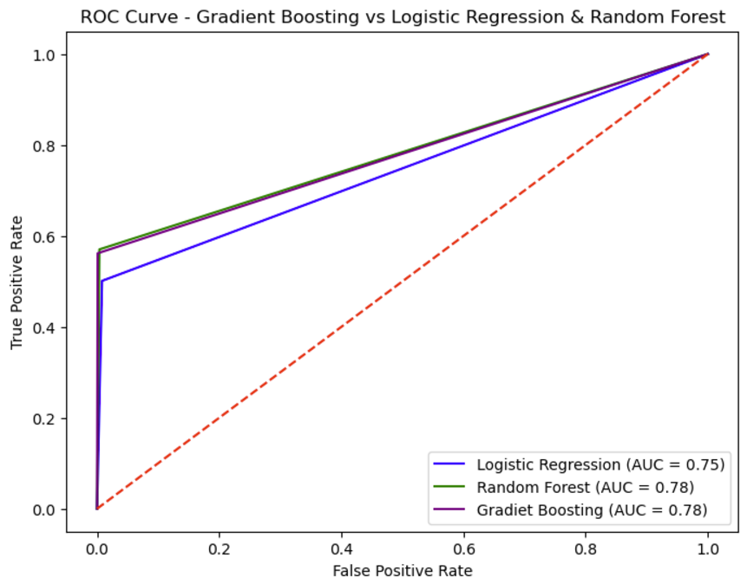
Navigating Q&A sessions
Result
Gradient Boosting and Random Forest achieved the highest AUC scores (0.78), outperforming Logistic Regression (0.75).
Cross-validation AUC-ROC:
Gradient Boosting (0.963),
Random Forest (0.963),
Logistic Regression (0.951).
Key features: BMI, blood glucose levels, and HbA1c levels were most predictive.

Slide 8
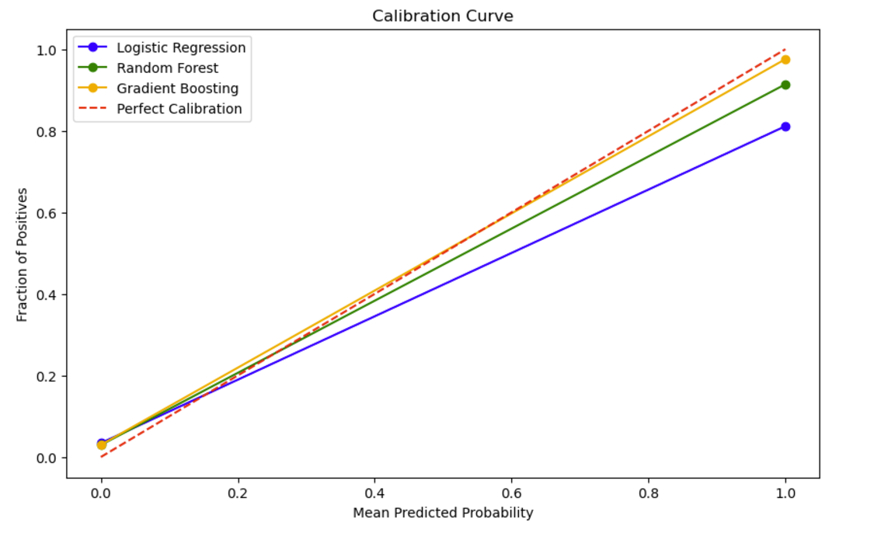
Recommendation
Primary Model: Gradient Boosting for its slightly better generalization and potential for improved predictions with hyperparameter tuning.
Alternative Model: Random Forest for comparable performance, faster training, and robustness.
Fallback Option: Logistic Regression if computational efficiency or interpretability is prioritized.

Slide 9
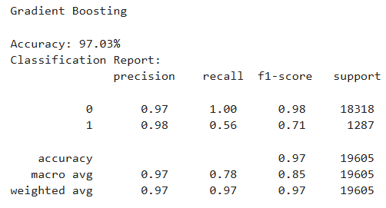
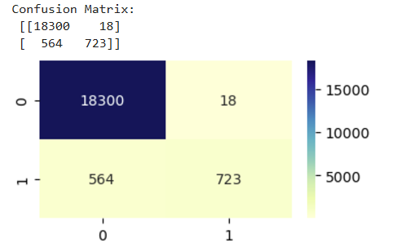
Gradient Boosting Model

Slide 10
Conclusion
1.
Gradient Boosting performs significantly better than other models, particularly in identifying diabetic cases (Class 1). The improved recall and F1-score for the minority class indicate the model is better at handling imbalanced data. However, there is still room to improve recall for Class 1 and reduce false negatives, which is critical in a healthcare setting

Slide 11
Thank you
Augustine Ogbonnah

